Slide 1

Manage all the clusters with KubeFleet and AKS Fleet Manager
Will Velida – Senior Software Engineer, Microsoft - @willvelida

Slide 2

About Me!
Senior Software Engineer at Microsoft, working in the Industry Solutions Engineering team.
Previously a Microsoft Azure MVP focusing on Kubernetes and Open Source.
Former rugby player (now I get my injuries through on-call).
Conference speaker and YouTuber: https://www.youtube.com/@willvelida
Notes:
Everyone does action figures, which was pretty cool, but I’d thought I’d give Lego Heads a try (you know the star wars ones? Any Lego fans here?)

Slide 4

Agenda
What is KubeFleet and AKS Fleet Manager?
Key Concepts

Slide 5
What IS kubefleet and ask Fleet manager?

Slide 6
KubeFleet - Managing and scaling apps across K8s Clusters
Multicluster deployment
Single control plane to deploy apps across multiple clusters.
Finds the best cluster to run on, and controls number of replicas on each cluster.
Scheduling Capability
Supports many K8s scheduling operations.
Introduces different multi-cluster policies
Metrics-based scheduling
Supports metrics-based placement strategies that ensure apps are allocated to most suitable cluster.
Built-in continuous deployment across K8s Clusters
KubeFleet has built-in rolling update strategy similar to K8s deployments.

Slide 7
AKS Fleet Manager = Managed KubeFleet
Create a Fleet and join AKS clusters across regions and subscriptions as member clusters.
Orchestrate K8s version and node image upgrades across multiple clusters.
Automatically trigger version upgrades when new K8s or node image versions are published (preview).
Create K8s resource objects on Fleet resource and propagate to member clusters
Export and import services between member clusters, and load balance incoming layer-4 traffic across service endpoints on multiple clusters (preview)

Slide 8
Key Concepts

Slide 9
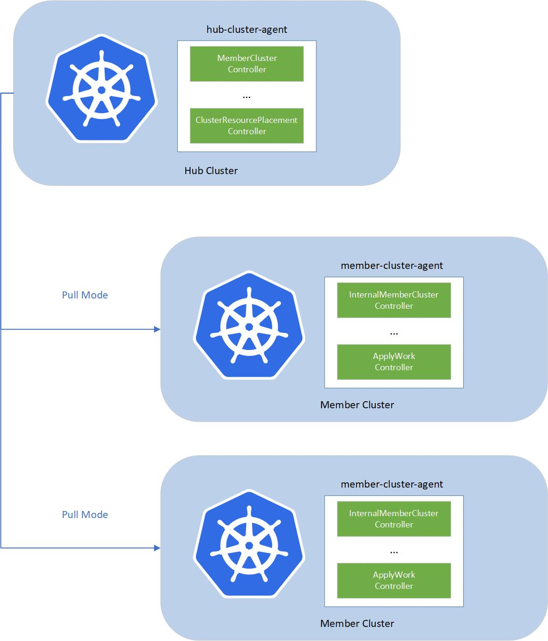
What are fleets?
Fleets act as a group entity for multiple Kubernetes clusters.
You use them to manage multiple clusters as a single entity, orchestrate updates and propagate resources across multiple clusters, and provide a single plane of glass for managing them.
A fleet consists of the following components:
fleet-hub-agent: A K8s controller that creates and reconciles all fleet-related CRs in the hub cluster.
Fleet-member-agent: A K8s controller that creates and reconciles all fleet-related CRs in member clusters.

Slide 10
Hub and Member Clusters
Hub clusters
Member clusters
In AKS Fleet Manager, hub clusters play a crucial role in managing multiple member clusters.
They facilitate orchestration of updates and resource management across member clusters.
You can create fleets without hub clusters
A member cluster represents a cluster within the hub cluster.
MemberCluster API used to identify registered clusters within a fleet.
You can join AKS clusters to a fleet as member clusters.
Member clusters must reside in same Entra tenant as the fleet, but can be in different regions, resource groups, and/or subscriptions

Slide 11
Which one do I use?
Capability | With Hub Cluster | Without Hub Cluster
Hub Cluster Hosting | ✅ | ❌
Update Orchestration | ✅ | ✅
Workload Orchestration | ✅ | ❌
Layer 4 load balancing | ✅ | ❌
Billing | Pay cost associated with the hub, which is a standard-tier AKS Cluster | No Cost
Converting fleet types | Can’t be downgraded to a K8s Fleet resource without a hub cluster | Can be upgraded to a Kubernetes Fleet resource with a hub cluster

Slide 12
Viewing member clusters

Slide 13
Updating member clusters

Slide 14
Deploying workloads across clusters

Slide 15
Useful AKS Fleet Manager and KubeFleet links
Roadmap: https://aka.ms/kubernetes-fleet/roadmap
Documentation: https://aka.ms/kubernetes-fleet
KubeFleet: https://kubefleet-dev.github.io/website/docs/

Slide 16


Thank you

